Slide 1
How we remember and why we forget (modules 24, 25, & 26)
Prof: Dr. Doe Buchli, PhD
Introductory Psychology
Fall 2016

Slide 2
What is memory?

Slide 3
Studying Memories
Memory
Persistence of learning over time through the encoding, storage, and retrieval of information
Evidence of memory
Recalling information
Recognizing it
Relearning it more easily on a later attempt
Notes:
Encoding
Process of getting information into the memory system
Storage
Process of retaining encoded information over time
Retrieval
Process of getting information out of memory storage

Slide 4
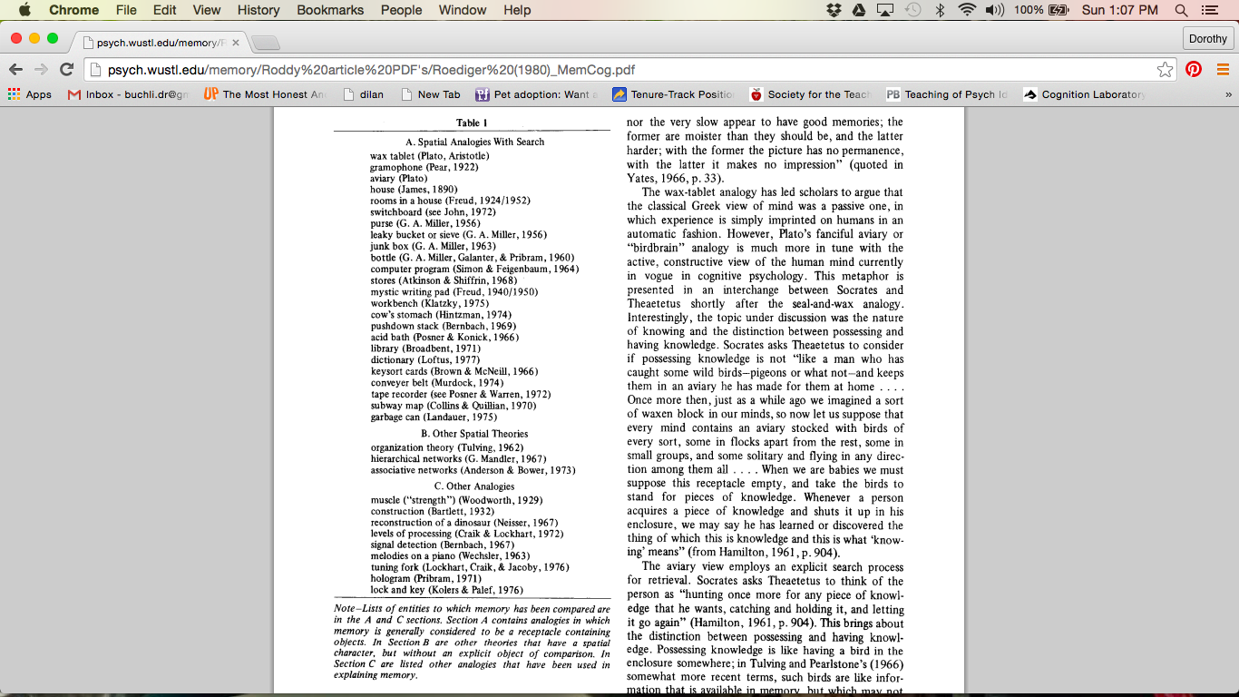
Metaphors for Memory
Roediger (1980)

Slide 5
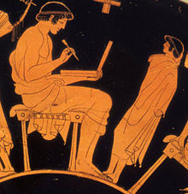
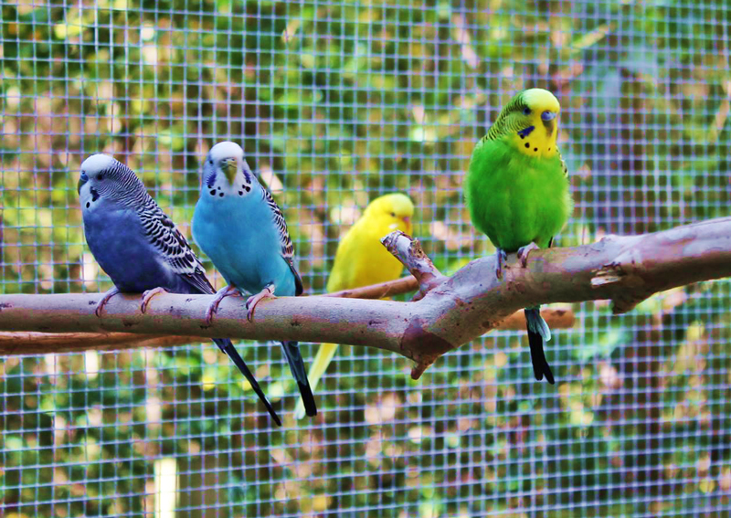
Metaphors for Memory
Roediger (1980)
Notes:
Plato was perhaps the first to propose a metaphor for memory, and he likened it to a wax tablet. So in these scheme, memory is a very passive process in which the act of experiencing something simply imprints onto your memory. He did account for individual differences somewhat by adding that some people’s wax was very sticky I guess and easily imprinted, while others were not and that some experiences make firmer imprints than others.
Then we come to Socrates who posited that memory was a much more active, user driven process similar to an avary full of birds. When you come into the world it’s empty but as you acquire knowledge it fills up. His analogy also goes beyond storage and talks about retrieval as an active, error prone process whereby one must reach for a given bird, and might sometimes take the wrong one
Possessing knowledge = storing birds in cage Having knowledge = recapturing birds and holding them in hand

Slide 6
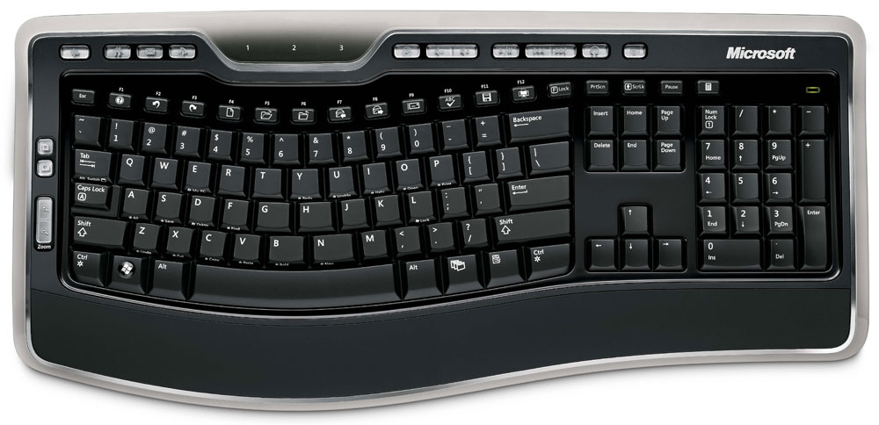

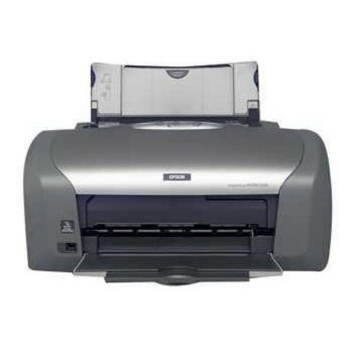
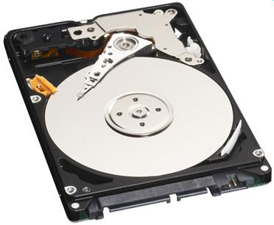
Notes:
Your PC acquires (or receives) input from a keyboard or a mouse;
it converts the symbols into a special numeric code;
it saves the information on a hard drive, CD, or disk;
it then retrieves the data from the disk to be displayed on a screen or sends it to a printer. -If the computer crashes, if there’s not enough space on the disk, if the file was deleted, or if you enter the wrong retrieval command, the information becomes inaccessible, or ‘forgotten

Slide 7
Information-Processing Model of Memory Modal Memory – Atkinson and Shiffrin
Retrieval
Stimulus
Sensory
memory
Attention
Short-term
memory
Long-term
memory
Encoding
Forgetting
Forgetting
Forgetting

Slide 8
Information-Processing Model of Memory
Retrieval
Stimulus
Sensory
memory
Attention
Short-term
memory
Long-term
memory
Encoding
Forgetting
Forgetting
Forgetting
Notes:
Sensory memory: stores all info acquired thru the senses, what you see, hear, etc. takes a brief snapshot of it, lasting only 200-500 milliseconds
Sensory memory stores:
Iconic – visual memory. 1-2 seconds
Echoic – auditory memory. 4 seconds
Haptic – touch/tactile memory. 5 seconds
olfactory bulb – smell memory? No olfactory sensory memory stores?
Capacity of sensory memory is unlimited

Slide 9
Information-Processing Model of Memory
Retrieval
Stimulus
Sensory
memory
Attention
Short-term
memory
Long-term
memory
Encoding
Forgetting
Forgetting
Forgetting
Notes:
Short term memory: sensations that you pay attention to are transferred to short term memory; holds 7 or so items of info for about 20 seconds
7 - 30 seconds
Capacity of short term memory is extremely limited. People can store up to 7 +- 2 units of memory
subvocal articulation / maintenance rehearsal

Slide 10
Information-Processing Model of Memory
Retrieval
Stimulus
Sensory
memory
Attention
Short-term
memory
Long-term
memory
Encoding
Forgetting
Forgetting
Forgetting
Notes:
Long term memory: permanent storage system; usually what people have in mind when they talk about memory; the average person stores five hundred times more info in a lifetime than what’s in the encyclopedia Britannica
Unlimited / permanent duration and capacity is unlimited

Slide 11
Long term memory
Events in your life == episodic memory
Facts about the world == semantic memory
Motor skills == procedural memory
Only a small amount of this knowledge is relevant at any moment
Short term memory
Used to keep track of what is currently relevant
Limited capacity
Short duration
Notes:
Hyperthymesia

Slide 12
Why are credit card numbers broken into groups of four digits? Four “chunks” are easier to encode (memorize) and recall than 16 individual digits.
→ Memorize: ACPCVSSUVROFLNBAQ XIDKKFCFBIANA
Chunking: organizing data into manageable units
XID KKF CFB IAN AAC PCV S SU VRO FNB AQ
Chunking works even better if we can assemble information into meaningful groups:
X IDK KFC FBI BA NAACP CVS SUV ROFL NBA Q
X IDK KFC FBI BA NAACP CVS SUV ROFL NBA Q
Notes:
Mnemonics memory

Slide 13
A Memory Experiment
You will be presented with 20 words, one after the other. Each word will be presented for 2 seconds.
Please try to remember the words for a later memory test. After the last word, you will see the word “recall”, at which point you should write down as many words as you can remember, in any order.
Any questions?

Slide 14
dime fork
bulb lion
bowl snake
cargo grill
petal lawn
smoke plank
book park
dwarf uncle
seat dance
rifle nurse

Slide 15
dime fork
bulb lion
bowl snake
cargo grill
petal lawn
smoke plank
book park
dwarf uncle
seat dance
rifle nurse

Slide 16
Characteristics of Free Recall
Good recall for words at end of list
Based on short term memory
Recency effect
1
Uncle
Dance
Nurse
0.9
0.8
0.7
0.6
0.5
0.4
0.3
0.2
0.1
0
1
2
3
4
5
6
7
Serial Position

Slide 17
Characteristics of Free Recall
Good recall for items at the beginning of the list (more rehearsal for early words → LTM)
Dime
Bulb
Bowl
1
0.9
0.8
0.7
0.6
0.5
0.4
0.3
0.2
0.1
0
Primacy effect
1
2
3
4
5
6
7
Serial Position

Slide 18
Typical order of recall of items in a free recall tests
Start with items from the end of the list
Recency
Then items from the beginning of the list
Primacy
Finally report items from the middle

Slide 19
What would happen to primacy and recency effects if you had to do something else in between hearing the end of the list and recalling the words?

Slide 20
With a delay between study and test…
No recency effect…WHY?
Primacy
effect

Slide 21
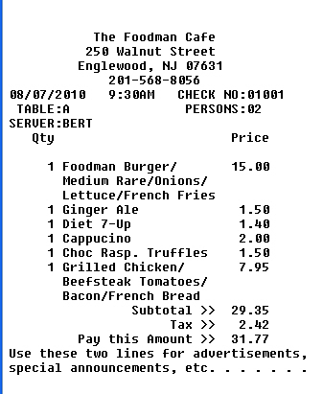
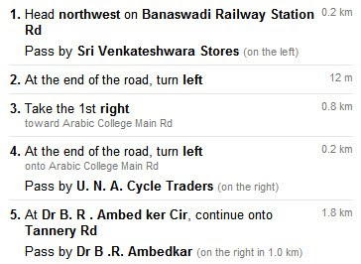
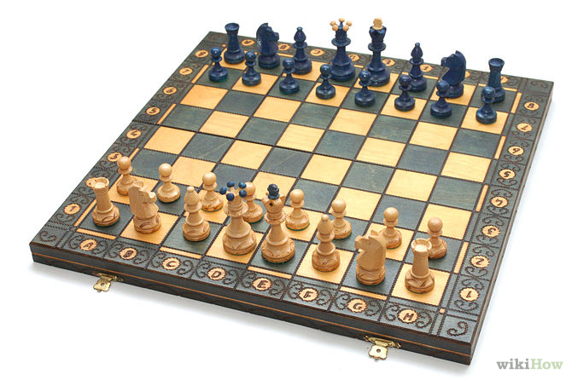

Slide 22
Updates to the information-processing model
Working memory, to stress the active processing occurring in the second memory stage
Automatic processing, to address the processing of information outside of conscious awareness
Just rehearsal isn’t enough to get info into LTM == must elaborate, build connections based on meaning

Slide 23
Working memory
Involves newer understanding of short-term memory
Focuses on conscious, active processing of incoming auditory and visual-spatial information, and of information retrieved from long-term memory
Is handled by a central executive (Baddeley, 2002)
Notes:
Functions of working memory
Conscious, active processing of incoming visual-spatial and auditory info
Focusing of attention (by central executive)
Every day we have occasion to keep particular pieces of critical information briefly in mind, storing them until the opportunity to use them arrives. Here are some examples: remembering a phone number between the time of hearing it and dialing it (“1 646 766-6358”); figuring a tip (the bill is $28.37, call it $30; 10 percent of that is $3.00, half of that is $1.50, $3.00 plus $1.50 is $4.50, the 15 percent you’re aiming for); holding driving directions in mind until you get to the landmarks you’ve been told to watch for (“take the first left, continue for one mile, past the school, bear right, left at the four-way intersection, then it’s the third building on the left— you can pull into the driveway”). Sometimes a problem offers multiple possible solutions, such as when you must look ahead along various possible sequences of moves in a chess game, and sometimes, as when you must untangle the structure of a complex sentence like this one, it is straightforward but nonetheless requires holding bits of information in mind until you can put it all together. In situations like these, not only do we need to keep certain bits of information accessible in mind, but also we need to perform cognitive operations on them, mulling them over, manipulating or transforming them. These short-term mental storage and manipulation operations are collectively called working memory. Think of working memory as involving a mental blackboard—that is, as a workspace that provides a temporary holding store so that relevant information is highly accessible and available for inspection and computation. When cognitive tasks are accomplished, the information can be easily erased, and the process can begin again with other information.

Slide 24
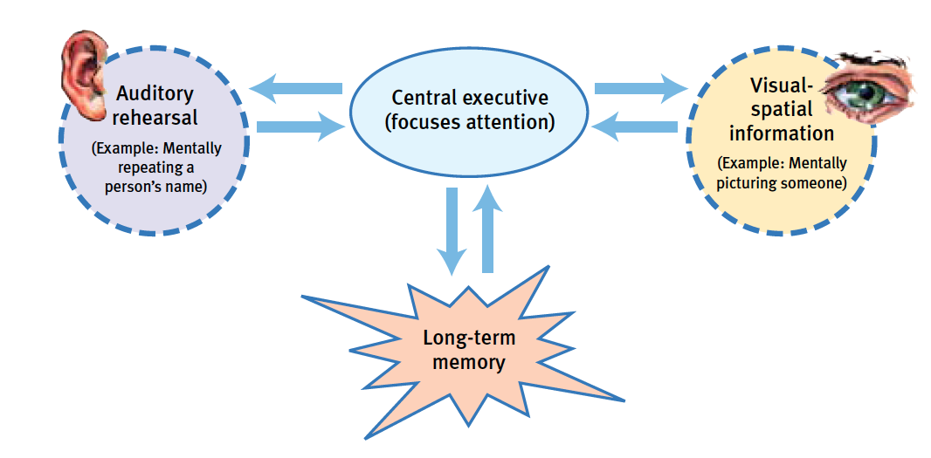
WORKING MEMORY
Alan Baddeley’s (2002) model of working memory, simplified here, includes visual and auditory rehearsal of new information. Part of the brain functions like a manager, a central executive focusing attention and pulling information from long-term memory to help make sense of new information.
Notes:
Think of working memory as involving a mental blackboard—that is, as a workspace that provides a temporary holding store so that relevant information is highly accessible and available for inspection and computation.
Phonological loop holds speech based information and also promotes rehearsal
Visual special workspace

Slide 25
Long Term Memory: Explicit and Implicit Memories
So far, we have been talking about explicit/ “declarative” memories: facts and experiences that we can consciously know and recall.
Some memories are formed without going through all the information processing stages. These are implicit memories, the ones we are not fully aware of and thus don’t “declare”/talk about.
Our minds acquire this information through effortful processing: Studying, rehearsing, thinking, processing, and then storing information in long-term memory.
These memories are typically formed through automatic processing. Implicit memories are formed without our awareness that we are building a memory, and without rehearsal or other processing in working memory.
Notes:
Instructor: you can add that explicit memories are also called “declarative” memories because we can easily state or “declare” that we know the information. On the other hand, knowing every step involved in getting somewhere is a memory we can form and use automatically without deliberately having to process it.

Slide 26
Automatic Processing Some experiences go directly to long-term implicit memory
Some experiences are processed automatically into implicit memory, without any effortful/working memory processing:
procedural memory, such as knowing how to ride a bike, and well-practiced knowledge such as word meanings
conditioned associations, such as a smell that triggers thoughts of a favorite place
information about space, such as being able to picture where things are after walking through a room
information about time, such as retracing a sequence of events if you lost something
information about frequency, such as thinking, “I just noticed that this is the third texting driver I’ve passed today.”
Notes:
Instructor: Here’s another conditioned response that is built on an automatically processed memory. The sound of a mortar launch can trigger a reaction in a child to look up to see fireworks, or trigger a reaction in a soldier that it’s time to duck and cover to avoid an incoming shell.

Slide 27
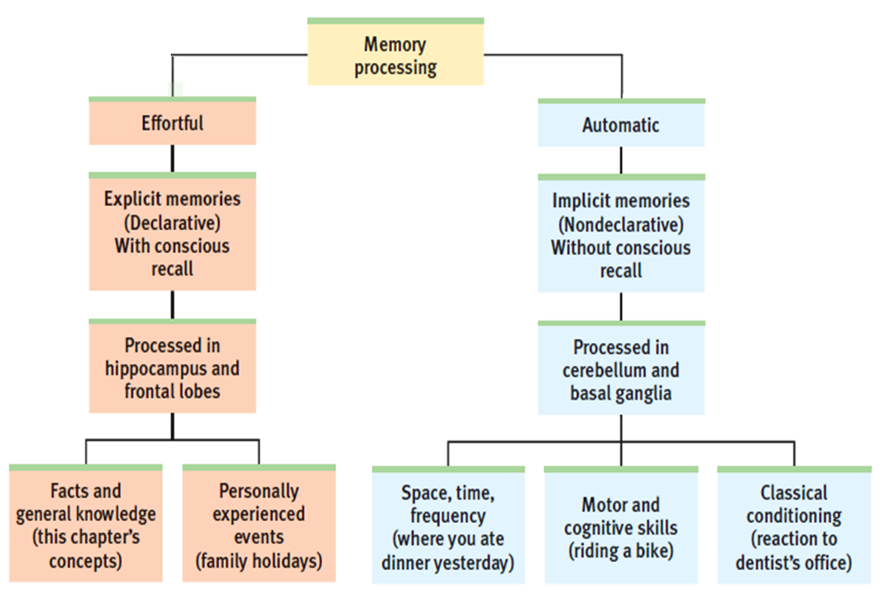

Slide 28
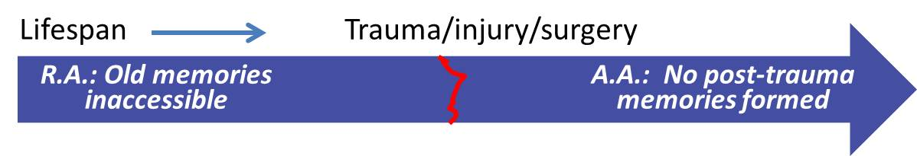
The Two Types of Amnesia
Retrograde amnesia refers to an inability to retrieve memory of the past.
Anterograde amnesia refers to an inability to form new long-term declarative/ explicit memories.
Retrograde amnesia can be caused by head injury or emotional trauma and is often temporary.
It can also be caused by more severe brain damage; in that case, it may include anterograde amnesia.
See also the movie Memento. Most other movie amnesia is retrograde amnesia.
Notes:
“H.M.” and “Jimmy” suffered from hippocampus damage and removal causing anterograde amnesia, an inability to form new long-term declarative memories.
They had no sense that time had passed since the brain damage. While they were not forming new declarative memories, encoding was still happening in other processing “tracks.”
Jimmy and H.M. could still learn how to get places (automatic processing), could learn new skills (procedural memory), and acquire conditioned responses
However, they could not remember any experiences which created these implicit memories.

Slide 29
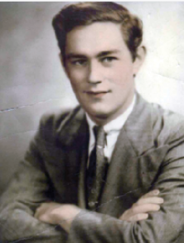

The Brain and the Two-Track Mind: The Case of Henry Molaison (“H.M.”)
In 1953, the removal of H.M.’s hippocampus at age 27 ended his seizures, but also ended his ability to form new explicit memories.
H.M. could learn new skills, procedures, locations of objects, and games, but had no memory of the lessons or the instructors. Why?
H.M. also retained memories from before the surgery. What is his condition called?
H.M., like another such patient, “Jimmy,” could not understand why his face looked older than 27 in the mirror. Why not?
Notes:
This is an optional slide explaining some elements of the previous slide, and it also can be used in place of the following slide.
H.M. actually had more parts of the temporal lobe removed, including the amygdala and parahippocampal gyrus.
Regarding the “why” question in the second bullet: these are examples of implicit memories and automatic processing (learning his way around a neighborhood or house), and are processed in other parts of the brain. H.M.’s experience helped confirm where in the brain different kinds of memories are formed.
The name of the condition is anterograde amnesia, covered on the next slide.
H.M. and “Jimmy” could not understand the aging in the mirror because they had no memory of all the days that had passed; age 27 felt like yesterday (or today) to H.M.

Slide 30
Dr. Claparede (~1920) described an amnesic patient (in 1911): “She could add and spell but did not recognize her doctors or nurses. When Claparede would meet his patients in the morning he would shake their hands. One day he hid a small pin in his hand. The amnesic patient got a small prick that morning. The next morning the patient hesitated, and didn’t want to shake his hand. She said, “Sometimes people hide things in their hands.”
Another example of implicit memory without explicit memory…

Slide 31

Clive Wearing Video

Slide 32
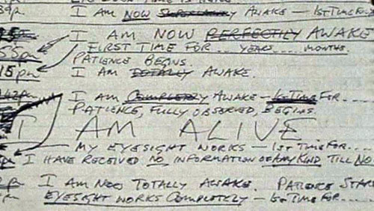
Clive Wearing’s Diary Entries…
Notes:
Looks at previous entry : no that wasn’t me, that wasn’t proper awareness
Goes through crossing out previous entries and underlining “Now” in the current entry

Slide 33
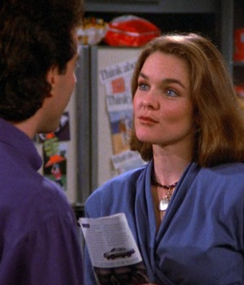
The Name Problem
Attention
Information overload
Single exposure
Arbitrary
Not unique

Slide 34
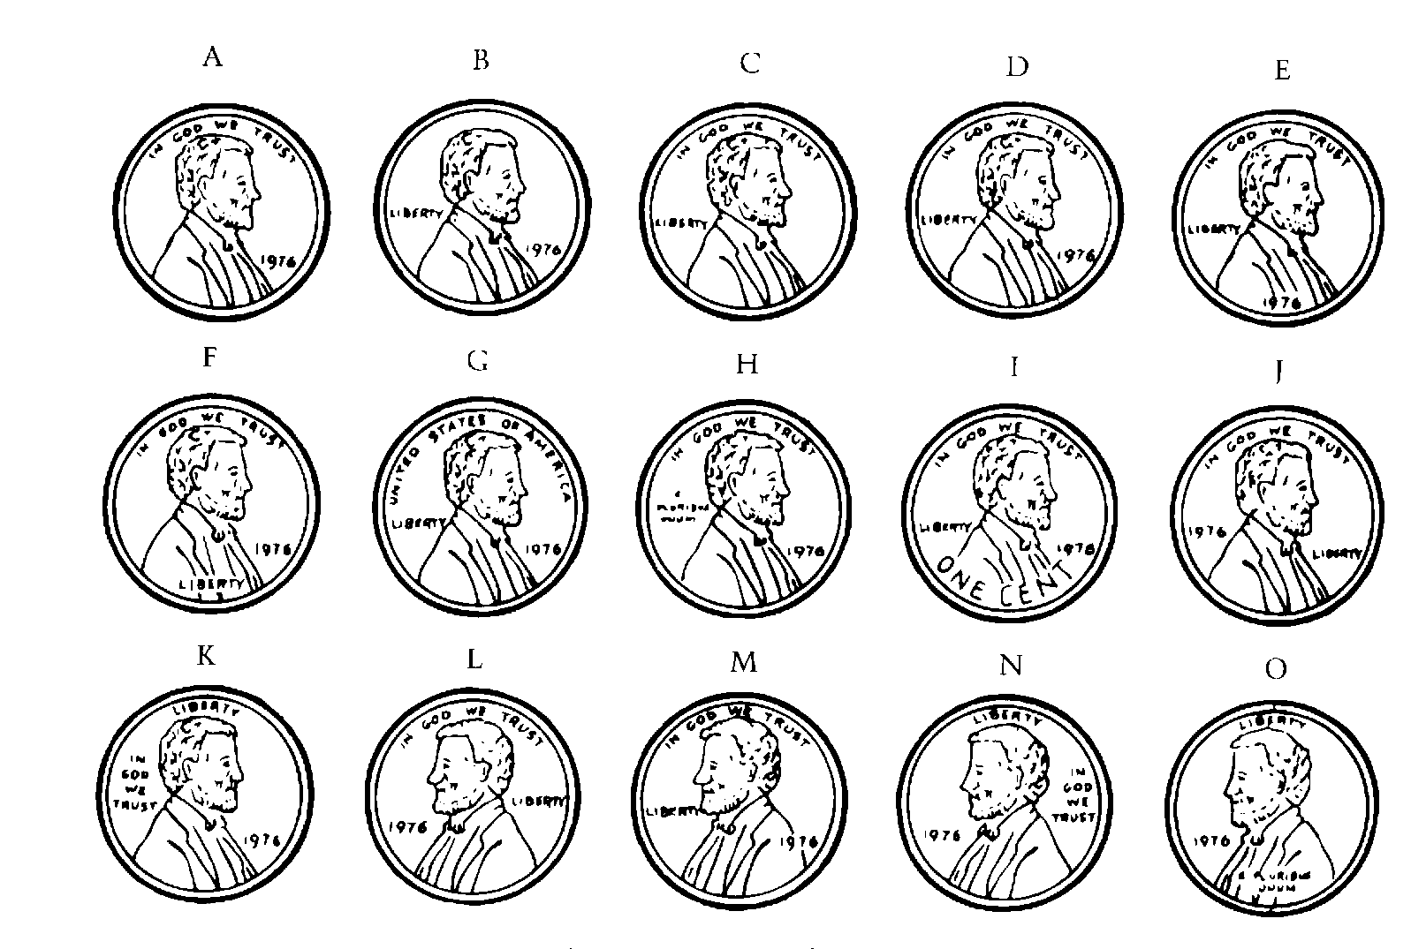
Which is the real penny?

Slide 35
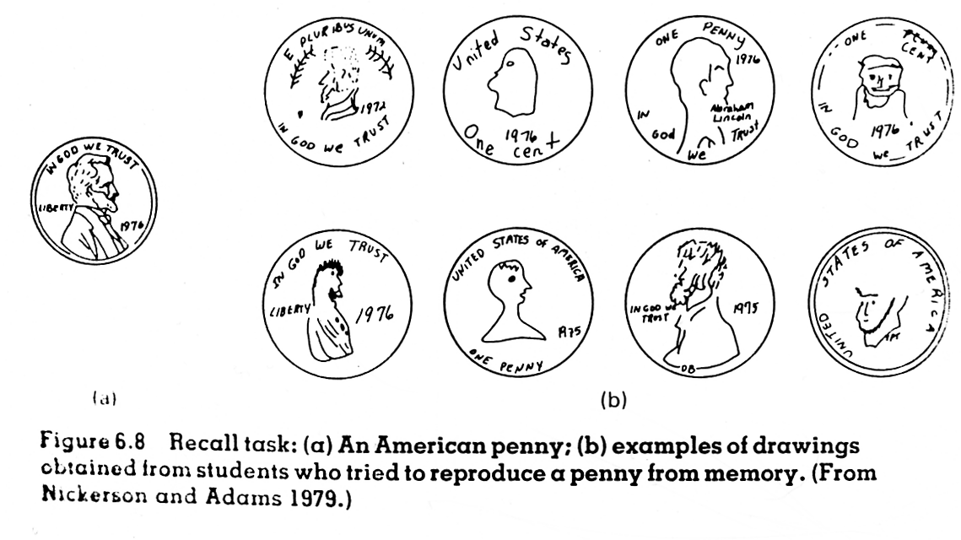

Slide 36
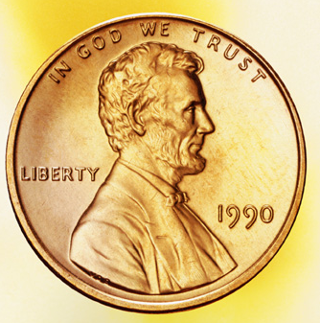
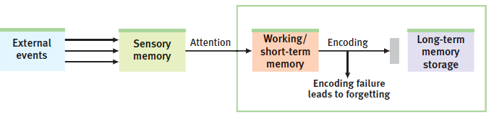
Encoding Failure
If we got the penny image wrong, did we fail to retrieve the information?
It could be that we never paid attention to the penny details and didn’t select them from sensory memory to hold in working memory.
Even if we once looked at the penny and paid attention to it, we still didn’t bother rehearsing it and encoding it into long term memory.
Notes:
Instructor: you can add that encoding ability declines with age, as well as working memory in general. For this reason, long term memories may be more reliable, accurate and complete than newly learned memories.

Slide 37
What is the capitol of Florida?
- The answer starts with a T…
- Sort of sounds like Tennessee, but that’s not it…

Slide 38
Retrieval Failure: Tip-of-the-tongue
Failure to retrieve a word from memory combined with:
Partial recall (we might know the first letter, words that sound similar, etc.)
Feeling that successful retrieval is about to happen
Universal experience
Regardless of race, culture, age, or intelligence
*Happens more frequently with age
What should you do when this happens?

Slide 39
Tip-of-the-tongue
Why does this happen?
Information you DO remember becomes very active
Alternate answers block recall
Become stuck in TOT state
What to do if this happens?
Think about something else

Slide 40
Theories of Forgetting
Lack of encoding
Don’t pay attention to & process the features that you need to remember a person or event
Decay
Memories fade with the passage of time
Interference
Some memories are blocked or displaced by other memories
Repression
Memories are blocked by unconscious processes
Associated with Freud
Notes:
Memory failure is a common experience in everyday life. Why? Do memory traces fade with time? Are they displaced by newer memories? Or do memories get buried, perhaps blocked by unconscious forces? As we’ll see, forgetting can result from one of four processes: a lack of encoding, decay, interference, or repression. In the first two, the forgotten information is simply not in long-term memory storage. In the second two, the memory may exist, but it is difficult, if not impossible, to retrieve.

Slide 41
Decay
Memory traces erode with the passage of time
Oldest theory of forgetting
Two major problems
No physiological evidence of decay
Time is not the most crucial factor
Notes:
The oldest theory of forgetting is that memory traces erode with the passage of time. But there are two problems with this simple explanation. One is that there is no physiological evidence of decay that corresponds to the fading of memory. The second is that time alone is not the most critical factor. Memory for newly learned nonsense syllables fades in a matter of hours, but the foreign language learned in high school is retained for many years.

Slide 42
Jenkins & Dallenbach, 1924
Presented a list of nonsense syllables to people and tested their memory after 1, 2, 4 or 8 hours. Sometimes they:
(1) Went to sleep between learning and test
(2) Stayed awake and performed normal daily activities
Results: people remembered more items at test after they had slept
Conclusion: wasn’t decay of memories, but displacement by other memories and activities after learning
Notes:
The key blow to the decay theory of forgetting was landed in 1924 by John Jenkins and Karl Dallenbach. Day after day, these researchers presented nonsense syllables to two subjects and then tested their memory after one, two, four, or eight hours. On some days, the subjects went to sleep between learning and testing; on other days, they stayed awake and kept busy. The subjects recalled more items after they had slept than when they were awake and involved in other activities. Jenkins & Dallenbach concluded that ‘forgetting is not so much a matter of decay of old impressions and associations as it is a matter of interference, inhibition, or obliteration of the old by the new.’ To minimize forgetting, you may find it helpful to go to sleep shortly after studying, thus avoiding ‘new information’ interference.
Consolodation for brain?

Slide 43
Interference
Interference
Learning some items may interfere with retrieving others, ultimately causing forgetting
Proactive interference
Old memories interfere with ability to remember new memories
Retroactive interference
New memories interfere with ability to remember old memories
Notes:
By showing that memory loss may be caused by mental activity that takes place when we are awake, Jenkins & Dallenbach’s study suggested a third explanation of forgetting – that something learned may be forgotten due to interference from other information. There are two kinds of interference. In proactive interference, prior information inhibits our ability to recall something new. If you try to learn a set of names, formulas, phone numbers, or glossary terms, you will find it more difficult if you had earlier studied a similar set of items. Many years ago, researchers found that the more nonsense-syllable experiments subjects had taken part in, the more forgetting they exhibited in a brand-new study.
A related problem is retroactive interference, whereby new material disrupts memory for previously learned information. Thus, subjects in various experiments are at least temporarily less likely to recognize previously seen pictures of nature scenes, faces, and common objects if they are then exposed to similar photographs before being tested. One learning experience can displace – or at least inhibit – the retrieval of another. That is why, when people go back and review a subset of to-be-remembered information, their memory for nonreviewed material suffers.

Slide 44
Repression
Defense mechanism to keep painful memories out of awareness
Difficult to study under laboratory conditions
Most people who experience trauma don’t forget; experience flashbacks & recurring memories
Some evidence from adults who report repressed memories
Suspect
Follow suggestions of therapist

Slide 45
Improving Your Memory
Examples:
Test yourself!
Spacing/distributed study
Chunking (grouping)
Mnemonics: images, maps, and peg-words
Deep/semantic processing
Making information personally meaningful

Slide 46


Mnemonics
A mnemonic is a memory “trick” that connects information to existing memory strengths such as imagery or structure.
Read: plane, cigar, due, shall, candy, vague, pizza, seem, fire, pencil
Which words might be easier to remember?
Write down the words you can recall.
Lesson: we encode better with the help of images.
A peg word system refers to the technique of visually associating new words with an existing list that is already memorized along with numbers. For example, “due” can be pictured written on a door, and door = 4.

Slide 47
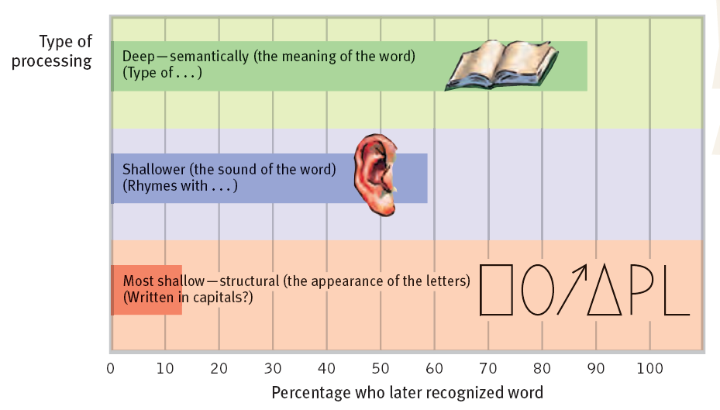
Deep/Semantic Processing
When encoding information, we are more likely to retain it if we deeply process even a simple word list by focusing on the semantics (meaning) of the words.
“Shallow,” unsuccessful processing refers to memorizing the appearance or sound of words.

Slide 48

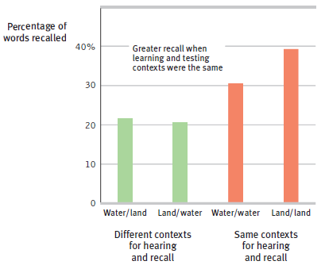
Context-Dependent Memory
Words learned underwater are better retrieved underwater.
We retrieve a memory more easily when in the same context as when we formed the memory.

Slide 49
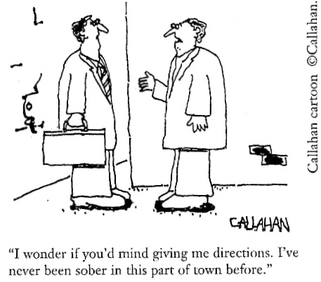
State-Dependent Memory
Memories can even be linked to physiological states:
Our memories are not just linked to the external context in which we learned them.
Memories can also be tied to the emotional state we were in when we formed the memory.
Mood-congruent memory refers to the tendency to selectively recall details that are consistent with one’s current mood.
→ This biased memory then reinforces our current mood!
“I wonder if you’d mind giving me directions. I’ve never been sober in this part of town before.”

